Slide 1
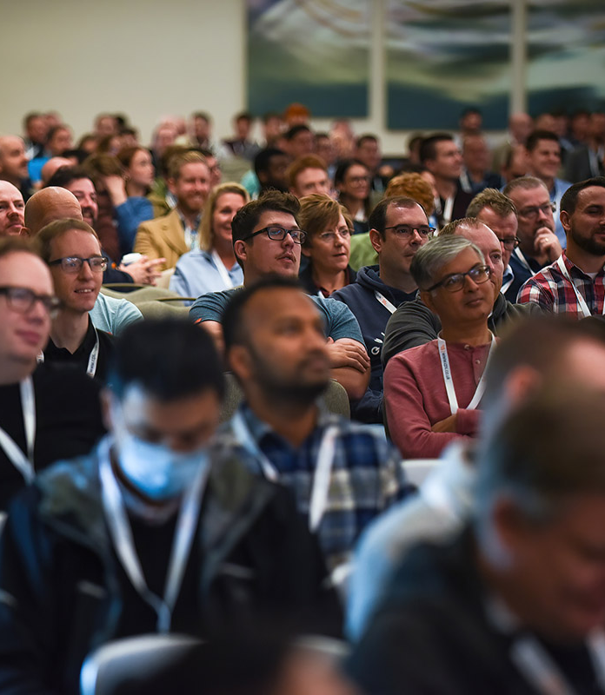
Lab 02: Build an agent with Copilot Studio
Notes:
MANDATORY SLIDE

Slide 2
Build an agent + add YOUR data
The low code way
Multiple approaches

Slide 3
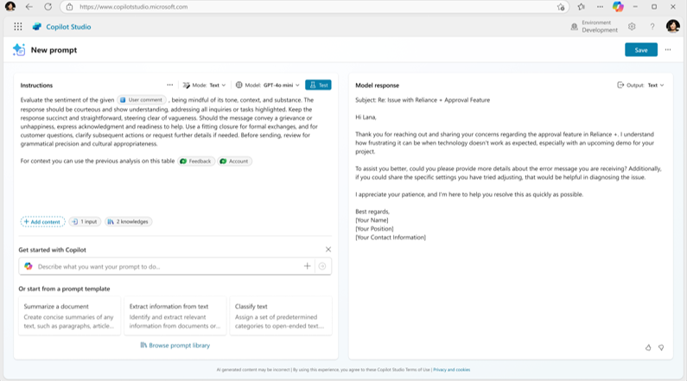
Extend with Prompts
Use prompts to perform specialized actions in your agents
Choose a specific model (GPT-4o mini, GPT-4o, o1) that is best suited to run a given task
Save to use in agents, flow or apps
Define input variables, to process text, documents or images
Define a specific output format (ex: JSON)
Add enterprise data as knowledge from Dataverse
Define precise prompt, allowing Generative AI to have specific instructions to perform individual tasks
Test AI action output, directly in the flow of work
Draft your prompt with Copilot or use prebuilt templates
Notes:
Thinking harder is great, but sometimes we need to steer our agents a certain direction and have more fine grain control over the output. That’s what Prompts enable us to do.
We can create a prompt for a specific task, specifying the instructions and desired output and integrate that with our Agents to execute based on certain conditions through a topic.
With Copilot Studio, you can choose the best model for each task—whether it’s GPT-4o mini, GPT-4o, or another specialized model.
Define input variables to process text, documents, or images, and add enterprise data as knowledge from Dataverse.
Draft precise prompts to give your agents clear instructions, and use prebuilt templates or Copilot’s suggestions to get started quickly.
You can even define specific output formats, like JSON, and test AI actions directly in your workflow.
The key is flexibility: you can apply models and customize prompts to fit your unique business needs, ensuring your agents deliver the right results every time.

Slide 4
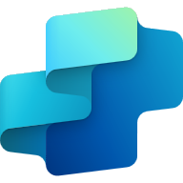
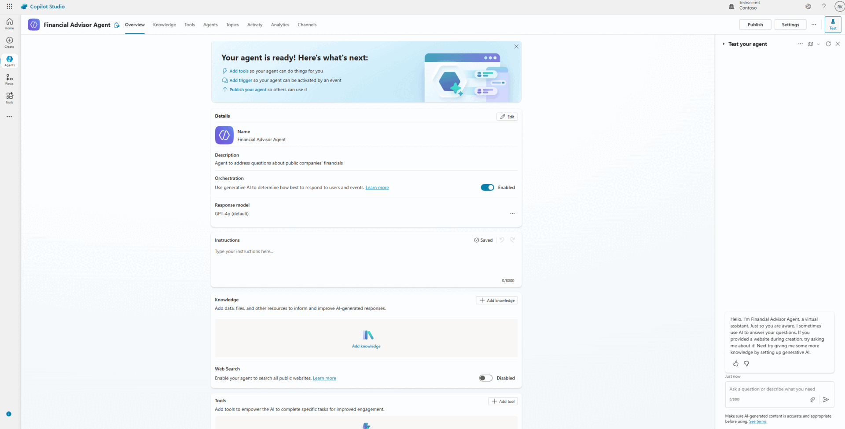
Bring Your Own Knowledge with Azure AI Search
Enable agents access to a diverse portfolio of AI models from Azure AI Foundry
Utilize company knowledge on Azure:
Leverage and unlock your knowledge with Azure AI Search for your agents
RAG on vectorized indices:
Utilize custom RAG built with Azure AI Search in Azure AI Foundry
Custom RAG without code:
Easy intuitive experience with no code
Notes:
Alex’s agents are even more effective when they can tap into Zava’s unique knowledge base. With Azure AI Search, Alex can connect internal documents, supplier data, and product catalogs to their agents. This gives the agents context-specific intelligence, whether Alex is using RAG on vectorized data or a no-code knowledge connection. Now, instead of generic answers, Alex’s agents respond with information pulled directly from Zava’s own systems.
Another powerful capability: bringing your own knowledge into Copilot Studio using Azure AI Search.
Agents can access a diverse portfolio of AI models from Azure AI Foundry and leverage your company’s knowledge stored in Azure.
With custom Retrieval-Augmented Generation (RAG) built on vectorized indices, you can unlock and utilize enterprise data for your agents—without writing code.
This makes it easy to create intuitive, knowledge-rich agents that deliver accurate, context-aware responses using your organization’s unique data assets.

Slide 5
Lab Scenario

Slide 6
IT Device Ordering
Internal device ordering process
Employees should in self service be able to pick a fitting laptop
Data from enterprise should influence the agents recommendations

Slide 7
Lab 02
Build an agent with Copilot Studio
https://aka.ms/scs25-copilot-studio

Slide 8




Thank you
Please provide feedback
Notes:
MANDATORY SLIDE – “Please use the QR code to provide session feedback.”

